Slide 1

Identify Courses
QEa23QE020

Slide 2

Team Members
Kishore
Varsha
Sowmiya
Merlina

Slide 3
Problem Statement
Search and display all web development courses 1. Should be for beginners level. 2. Courses offered in English language 3. Display first two courses with name, total learning hours and rating.
(Suggested Site: coursera.org however you are free to choose any other legitimate site)

Slide 4
Detailed Description
1. Search for web development courses for Beginners level & English Language and extract the course names, total learning hours & rating for first 2 courses
2. Look for Language Learning; Extract all the languages and different levels with its total count & display them
3. In Home page, go to "For Campus” at bottom of the page; and click “Contact us” and fill the form with any one input invalid (example: email); Capture the error message & display (Suggested Site: coursera.org however you are free to choose any other legitimate site) (Suggested Site: coursera.org however you are free to choose any other legitimate site)

Slide 5
Key Automation Scope
Handling different browser windows, search option
Extract multiple drop down list items & store in collections
Navigating back to home page
Filling form (in different objects in web page)
Capture warning message
Scrolling down in web page

Slide 6
PREREQUISITES
Website used:
https://www.coursera.com/
Tools/Software's Used:
Selenium – Portable Framework for testing Web Applications and automating the process.
Java – High level Programming Language.
Eclipse – Integrated Development Environment for various ‘Languages’.

Slide 7
Tools and Frameworks
TestNG – Open source testing framework
POM – Object repository design pattern.
Apache POI – It is a POI library written in Java that gives users an API for manipulating Microsoft document.

Slide 8
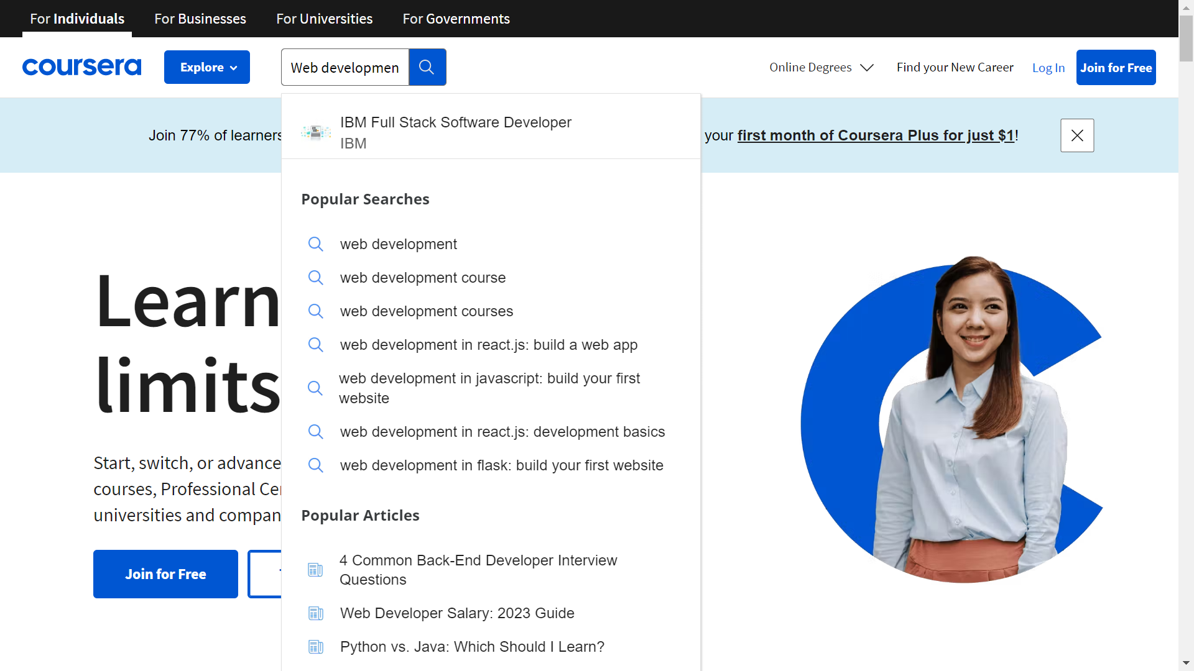

Slide 9
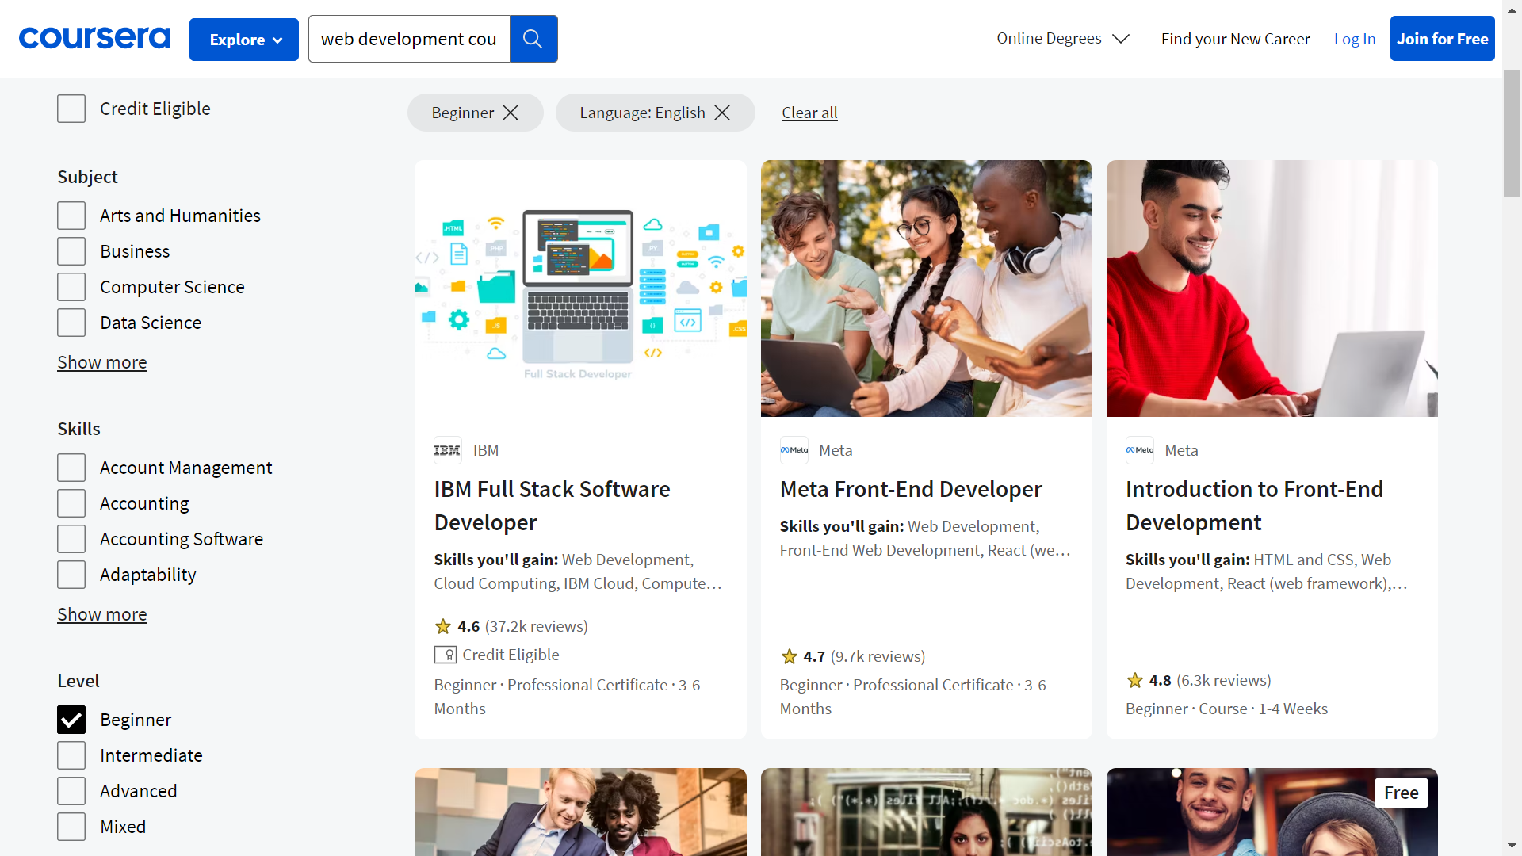

Slide 10
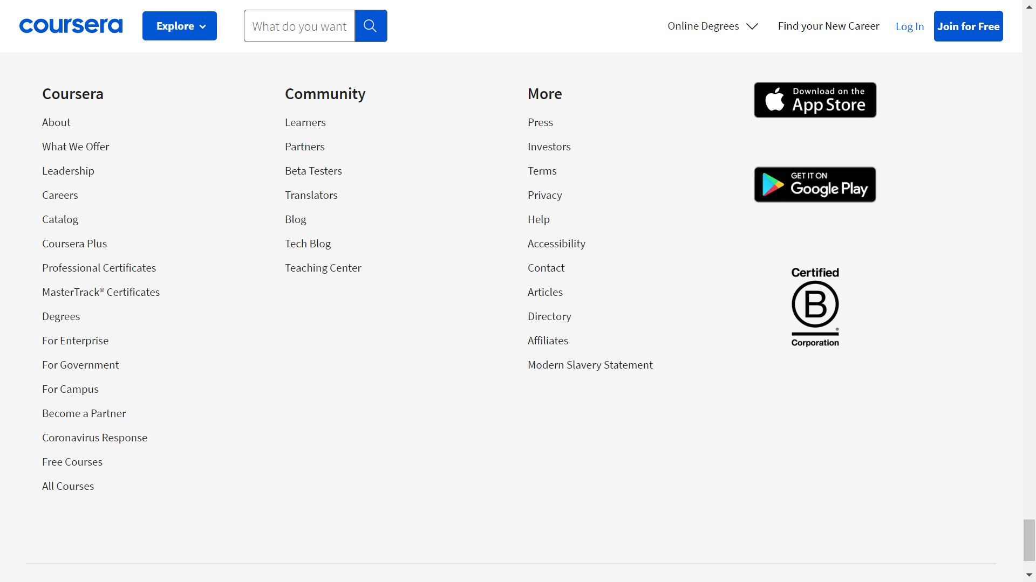

Slide 11
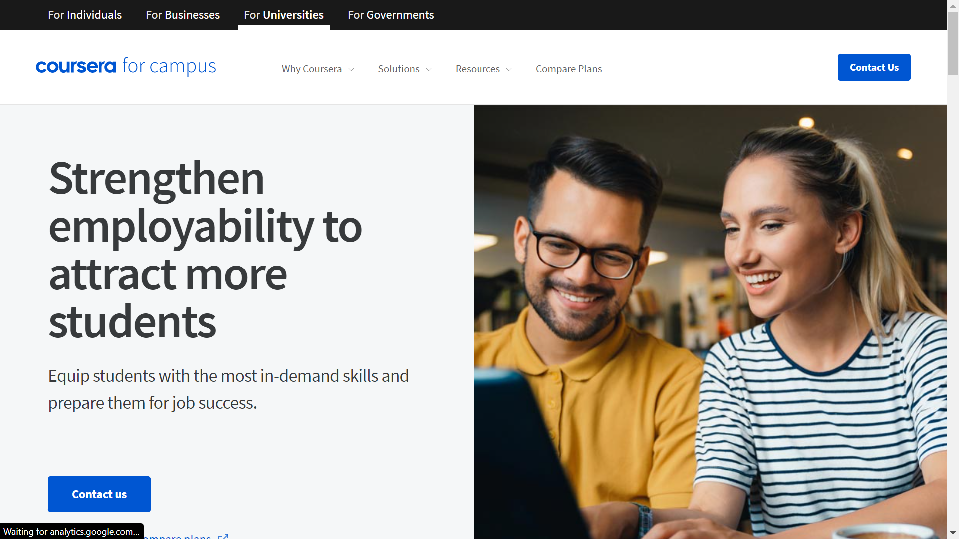

Slide 12
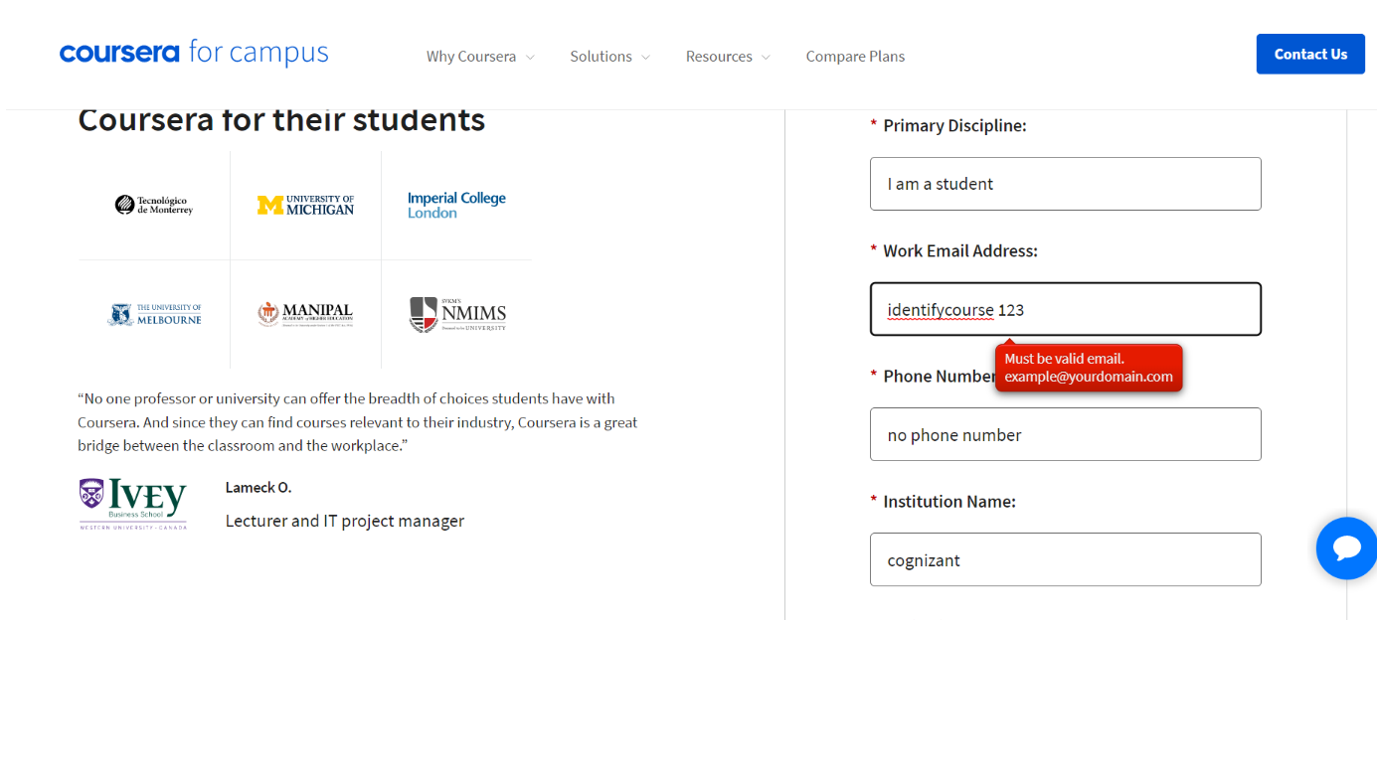

Slide 13
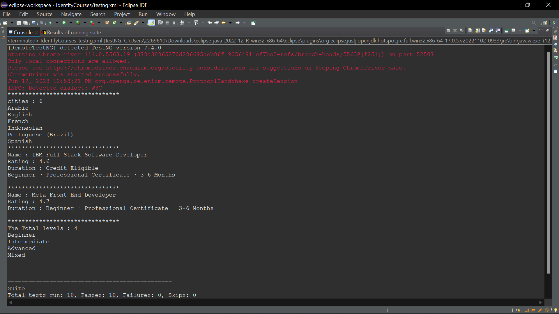

Slide 14
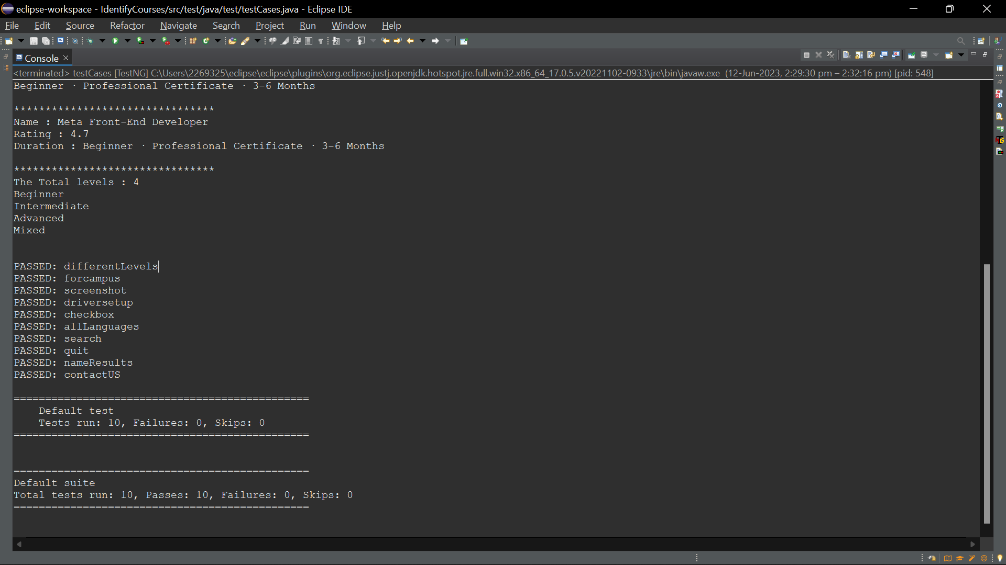

Slide 15

Thank You

